Slide 1
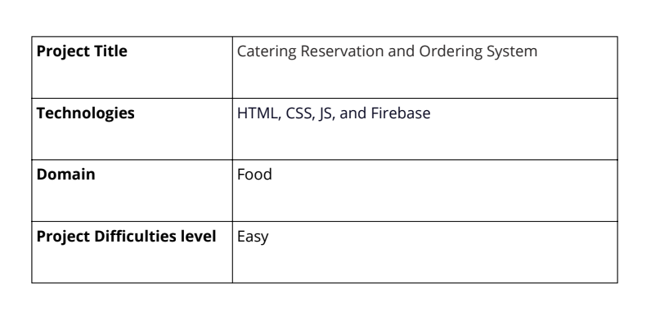
PROJECT 2(Advance) -Catering Reservation and Ordering System
-SUBMITTED BY
PRNICE DEEPAK J K

Slide 2
abstract
An Online Food Ordering System streamlines the food ordering process by providing a user-friendly interface. It continuously updates menus and available options, enhancing customer oversight. Customers can select multiple items, review their order details, and receive confirmation before logging off. Orders are promptly placed in a queue, updated in real-time in the database, and confirmed to the customer. This system enables efficient real-time order management for staff, benefiting the food delivery industry by facilitating quick and convenient service directly to customers' locations. Restaurant employees manage orders through a straightforward graphical interface, ensuring swift and convenient processing.

Slide 3
introduction
The Online Food Ordering System provides a convenient way for customers to purchase food from restaurants without physically visiting them. Enabled by the internet, this system connects customers directly with restaurants or food companies. Customers visit the restaurant's website, browse through available food items, select their choices, and make purchases. The ordered items are then delivered to the customer's doorstep at their chosen time by a delivery person.
Payments for online orders can be made through various methods such as debit cards, credit cards, cash on delivery, or digital wallets, ensuring security and convenience. This system has gained popularity for its safety and efficiency, revolutionizing the food industry by simplifying the ordering process.
The proposed Online Food Ordering System is designed specifically for fast food restaurants, take-outs, and college cafeterias, but it can be adapted for any food delivery service. It automates the entire ordering process, making it easier for both customers and restaurants. Customers access an interactive menu on the ordering webpage, displaying all available options with dynamic pricing based on selections. Once items are added to their order, customers can review details before finalizing their purchase.

Slide 4
Problem statement
Catering is an online platform designed to empower local entrepreneurs, particularly in rural areas, by enabling them to showcase and sell their catering services globally. The project aims to create a secure portal accessible via mobile devices, allowing users to purchase catering services from administrators. Emphasis is placed on fostering skill development among caterers and promoting traditional Indian culture through their offerings.

Slide 5
objectives and goals
The proposed system is designed to streamline order management processes in fast food restaurants. It includes functionalities for customers to create, review, and modify their orders before payment, which can be made via prepayment cards, credit cards, or debit cards.
The graphical user interface features sections for promotions and menu items, prioritizing a seamless user experience. Importantly, it conceals detailed customer order information from the front-end and kitchen staff, focusing on efficient order delivery.
The system also incorporates tools for generating decision-making reports and allows management to update food information such as prices, menus, and promotions. It includes functionalities for user management and system menu maintenance.

Slide 6
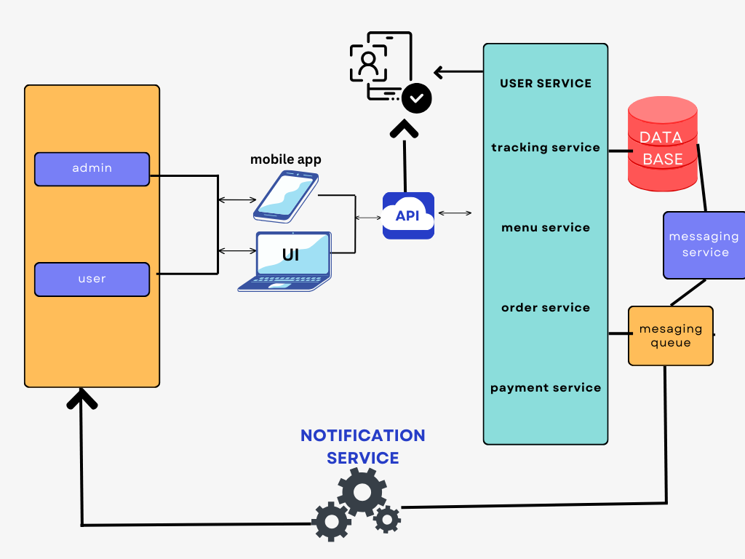
Architecture

Slide 7
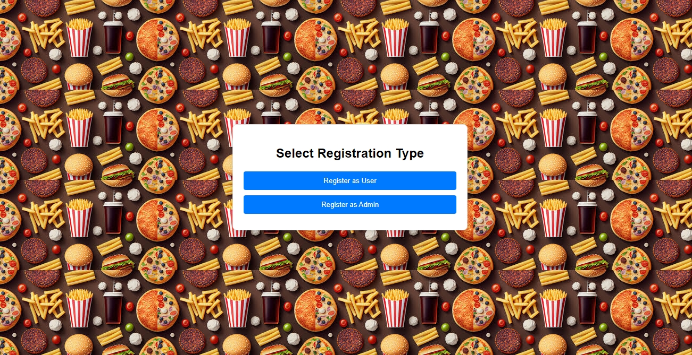
OUTPUT SCREEN :
Page 1 :

Slide 8
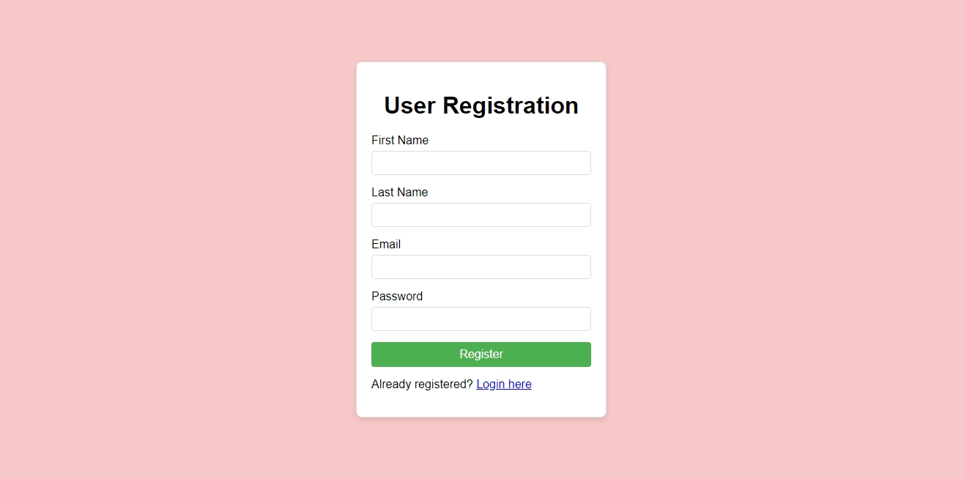
IF USER CHOOSE THE REGISTER AS USER:
PAGE 2.1 [USER REGISTER PAGE]:

Slide 9
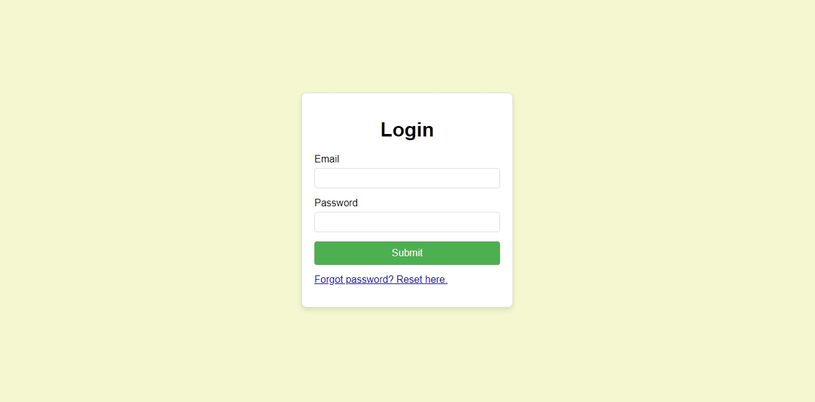
PAGE 2.2 [USER LOGIN PAGE]:

Slide 10
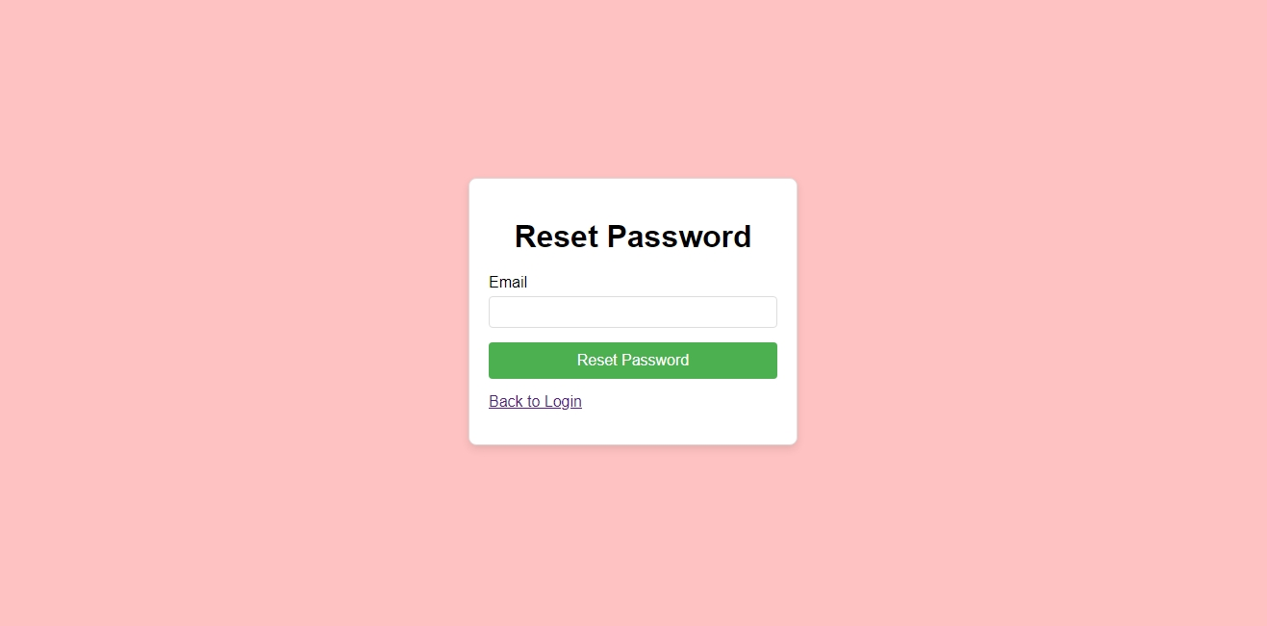
PAGE 2.3[USER PASSWORD RESET PAGE]:

Slide 11
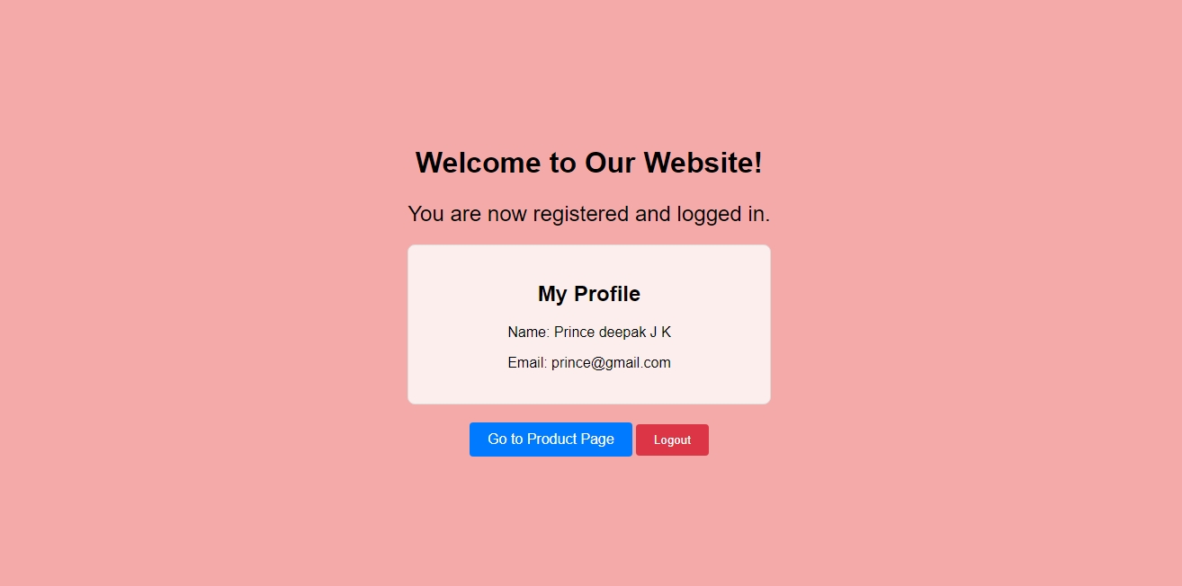
PAGE 2. 4 [USER HOME PAGE]:

Slide 12
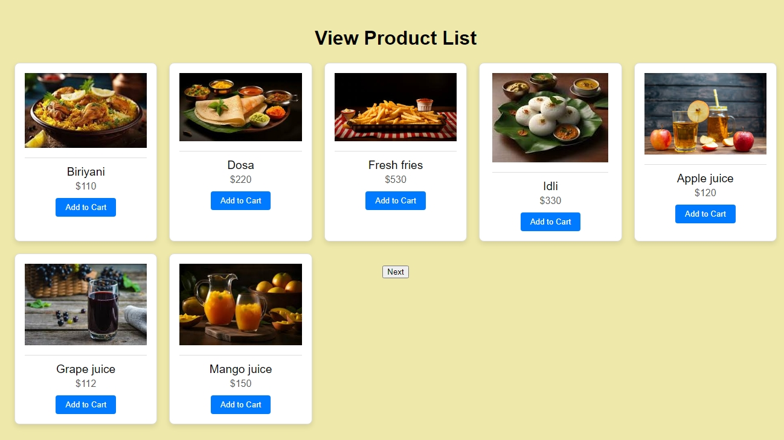
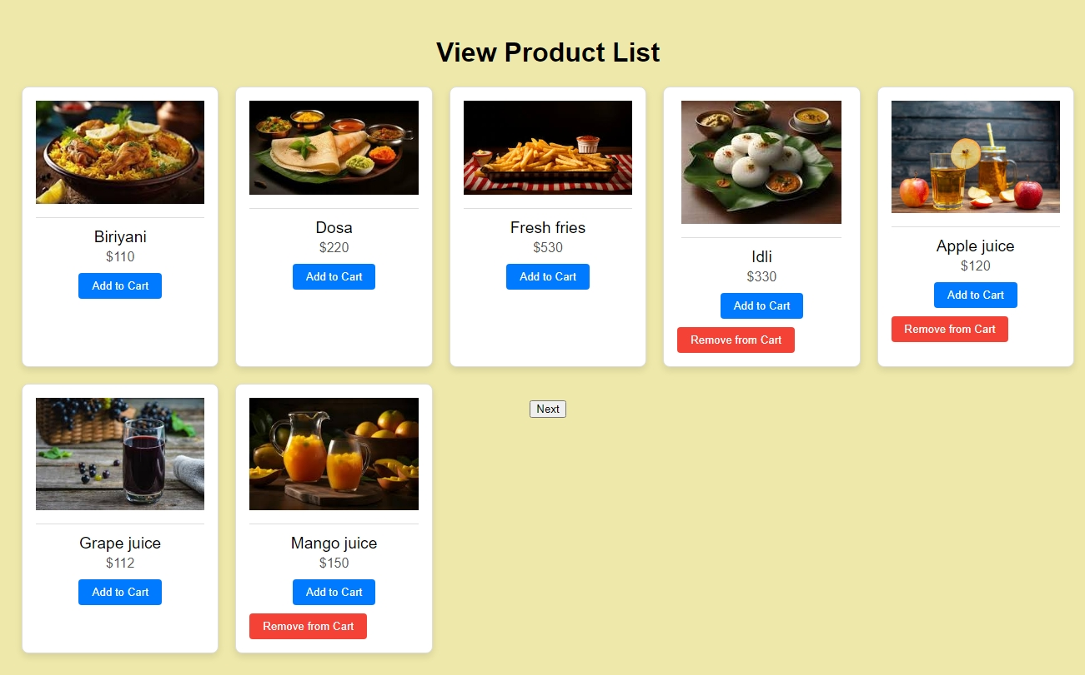
PAGE 2. 5 [USER VIEW PRODUCT PAGE]:

Slide 13
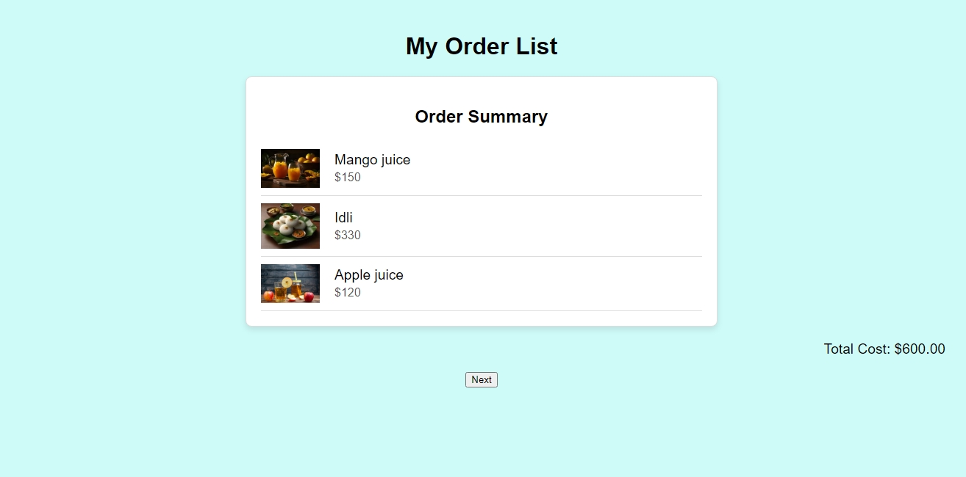
PAGE 2. 6 [MY ORDER PAGE]:

Slide 14
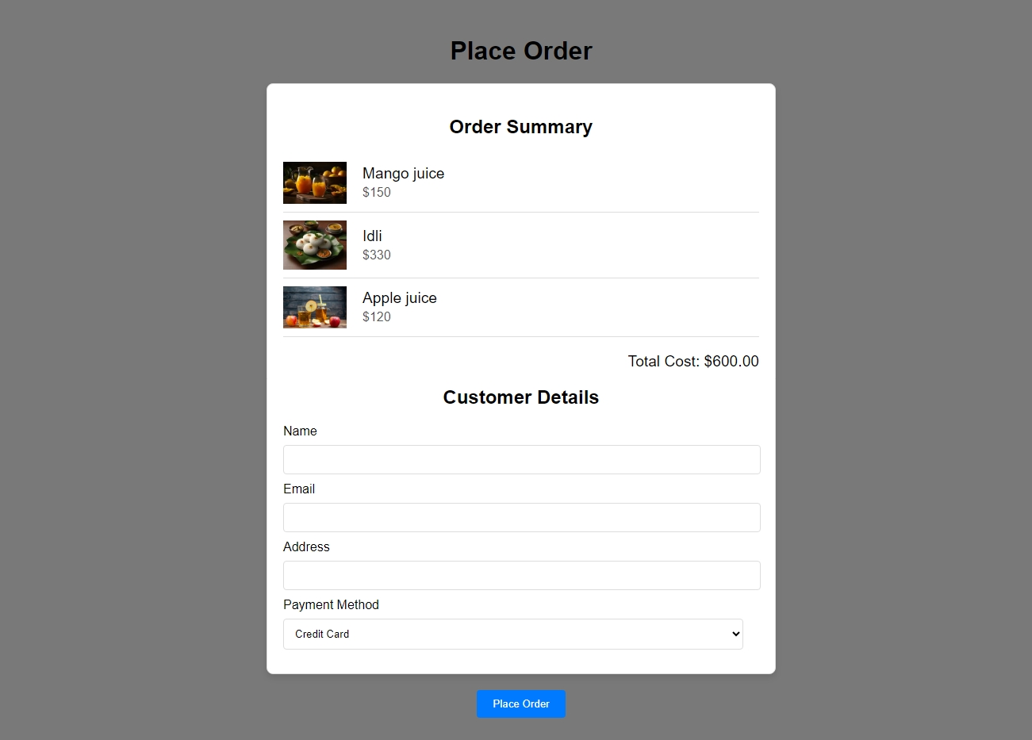

PAGE 2. 7 [PLACE ORDER PAGE]:

Slide 15
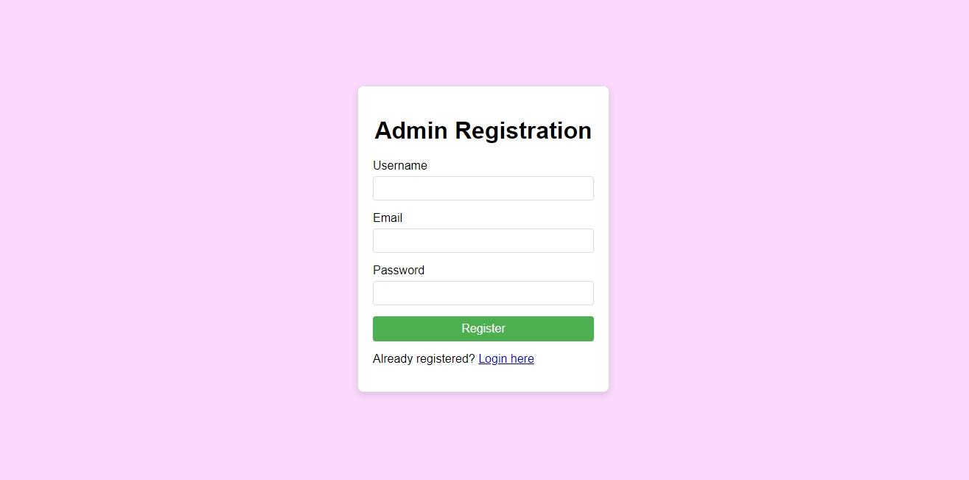
PAGE 3. 1 [ADMIN REGISTER PAGE]:

Slide 16
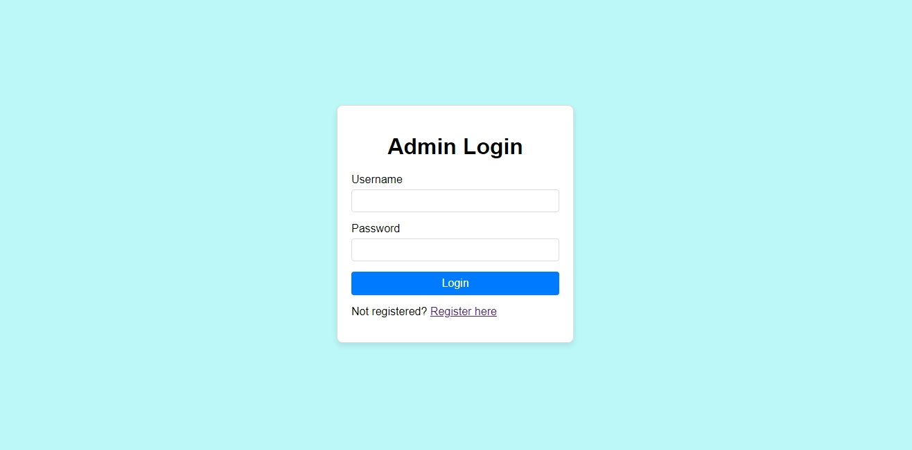
PAGE 3. 2 [ADMIN LOGIN PAGE]:

Slide 17
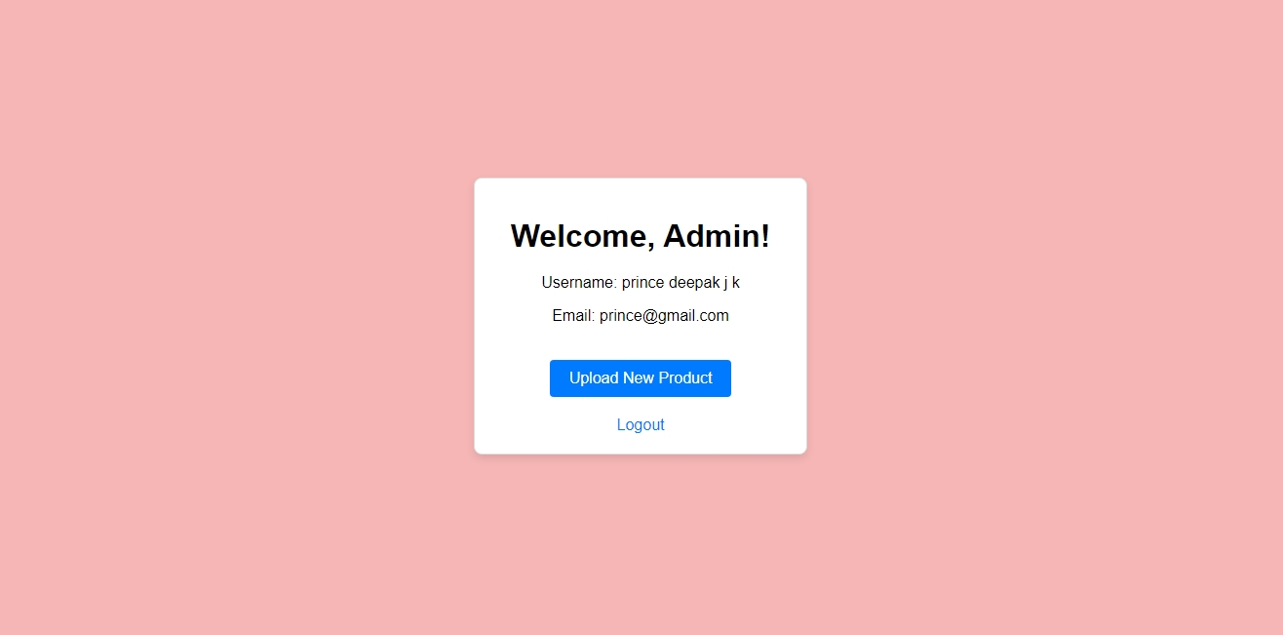
PAGE 3. 3 [ADMIN HOME PAGE]:

Slide 18
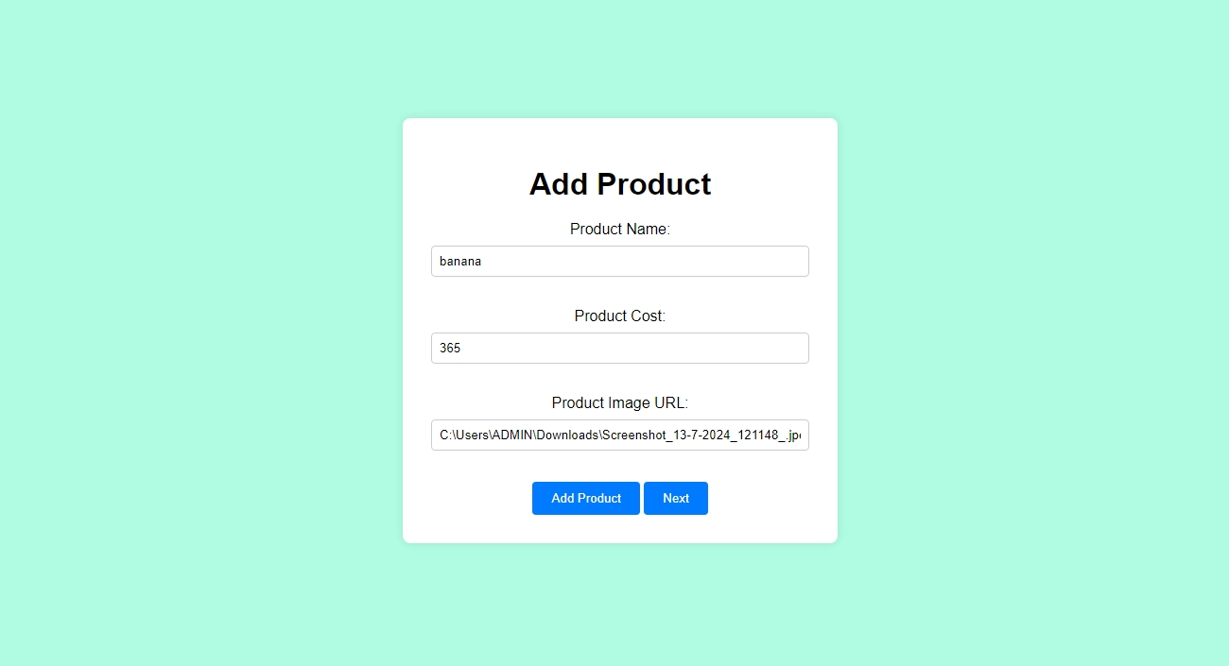
PAGE 3. 4 [UPDATE PRODUCT PAGE]:

Slide 19
CONCULSION:
The Catering website project transforms how rural caterers reach global markets, promoting their products and preserving traditional Indian culinary heritage. By providing a robust online platform, the project empowers local developers to securely showcase their skills via mobile devices, supporting economic growth in rural areas and fostering cultural exchange. This initiative uplifts rural communities, equipping them with tools to thrive in the digital economy while safeguarding India's diverse culinary traditions. The platform creates a sustainable ecosystem where traditional knowledge meets modern technology, benefiting both producers and consumers through direct global market access.

